Slide 1

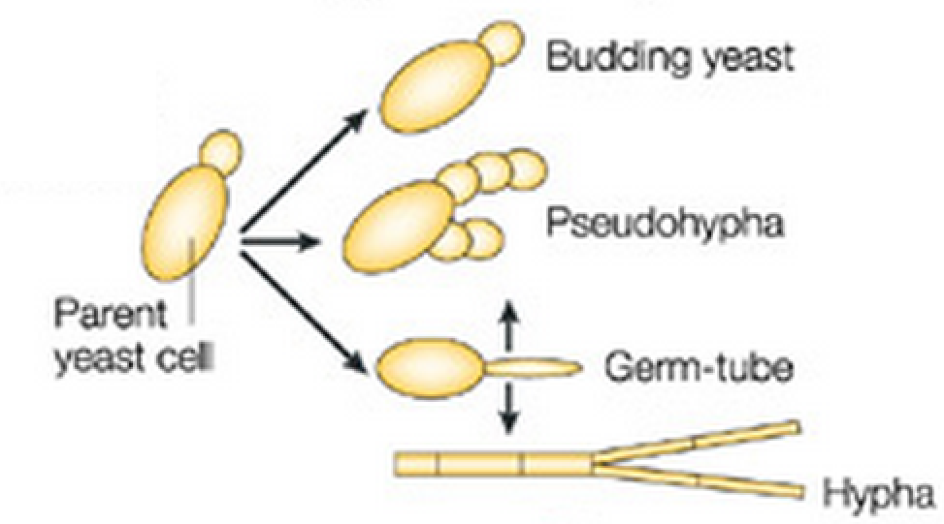
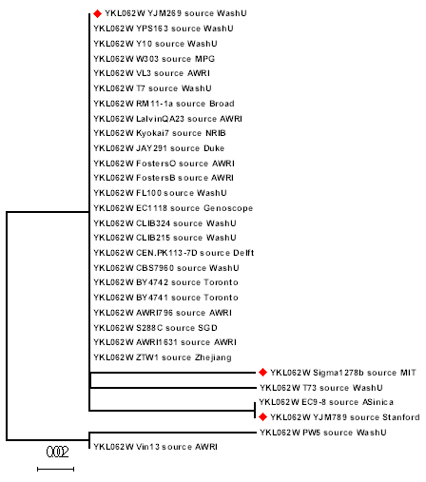
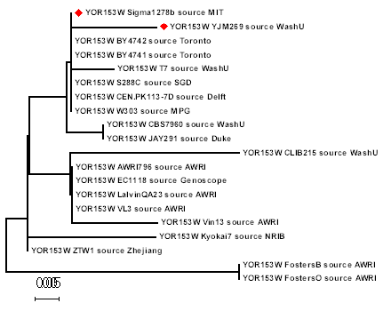
Comparison of Pathogenic and Non-Pathogenic Yeast Genomes
Deja Heckard, Kaitlyn Jackson
Abstract
Saccharomyces cerevisiae is a single cell organism that is historically used in bread making and brewery. Recently, it has been reported that some strains of S. cerevisiae, including YJM789, YJM222, and YJM308, are opportunistic pathogens. We hypothesized that mutational changes in chaperone proteins contribute to the pathogenicity in the virulent strains because our body temperature is 37⁰C, higher than the temperature that yeast cells typically survive in. In this study, we will compare the cis-regulatory and coding sequences of heat shock pathways, such as Hsp60, Hsp70, Hsp90, and Hsp104 in virulent and non-virulent strains. Furthermore, we studied the sequence variation of gene SSD1 which regulates yeast cell wall structures. Sequence variations that were enriched in the pathogenic strains but not in the non-pathogenic strains are likely to be involved in the genetic mechanisms leading to the emergence of virulence.
Actin
Cytoskeleton
PDR5
Drug transporter
0.005
0.002
Objective
Conclusion
The objective of this study was to find and compare the genetic sequencing of examples of virulent and non-virulent yeast strains. Through this study, and the information used, the group hoped to find similar genes that make different strains of yeast pathogenic.
Due to the high volume of genes involved with virulence in this species, we were unable to definitively determine which gene(s) are responsible for making some strains pathogenic. However, we are able to determine that pathogenic strains of yeast differ from non-pathogenic strains in more way than one. Evidence for there being multiple genes that regulate virulence shows that pathogenic yeast have been subjected to a number of mutations, not just one, that allow them to live at high temperatures.
Methods
A summary table of candidates genes that should be explored further.
Genes that do not clear information on pathogenicity.
Not enough sequence:
ATP6, COX1, COX2
This research project was conducted through meta-analysis. The group utilized information about the morphologies of each gene that had already been found and published in other articles. BLAST was also used to compare the genomes of the different strains of yeast. Then, once the group knew what the differences in genetic sequencing were in said strains of both pathogenic and non-pathogenic Saccharomyces cerevisiae, MEGA was used in order to create a three-dimensional rendering of the genetic information and single out the specific genetic difference in each strain.
Data and Results
Based on a comparison of genes between the pathogenic and non-pathogenic strains of yeast, we found that there are multiple genes that contribute to the virulence of the yeast. For example, there are multiple genes associated with the ability of pathogenic yeast to live at higher temperatures than normal. Contrary to our original belief, this ability of pathogenic yeast is not merely the result of differences in the proteins of heat shock pathways.
References
Engel , S. R., & Cherry, J. M. (2013). The new modern era of yeast genomics: community sequencing and the resulting annotation of multiple saccharomyces cerevisiae strains at the saccharomyces genome database . (Master's thesis)Retrieved from http://database.oxfordjournals.org/content/2013/bat012.full
McCusker, J. H., Clemons, K. V., Stevens, D. A., & Davis, R. W. (1993). Genetic characterization of pathogenic saccharomyces cerevisiae isolates. (Master's thesis)Retrieved from http://www.genetics.org/content/136/4/1261.full.pdf html
McCusker, J. H., Wei , W., Hyman, R. W., & Jones , T. (2007). Genome sequencing and comparative analysis of saccharomyces cerevisiae strain yjm789. (Master's thesis)Retrieved from http://www.pnas.org/content/104/31/12825.full.pdf html
Klingberg, T. D., Lesnik, U., Arneborg, N., Raspor, P., & Jespersen, L. (2008). Comparison of saccharomyces cerevisiae strains of clinical and nonclinical origin bymolecular typing and determination of putative virulence traits. (Master's thesis)Retrieved from http://www.ncbi.nlm.nih.gov/pmc/articles/PMC2430332/pdf/fyr0008-0631.pdf

